Slide 1
Take a Walk on the Client-Side

Slide 2
Fiddler

Slide 3
Semantic Markup and Css-Based Design

Slide 4
Use a Css Reset
http://meyerweb.com/eric/tools/css/reset/

Slide 5
5 Minutes to Floats

Slide 6

Book
Designing with Web Standards by Jeffrey Zeldman and Ethan Marcotte

Slide 7
Css Inheritance

Slide 8

Book
Bulletproof Web Design by Dan Cederholm

Slide 9
Flexible Web Fonts

Slide 10
Cool Stuff from Css 3

Slide 11
Embrace Graceful Degradation

Slide 12
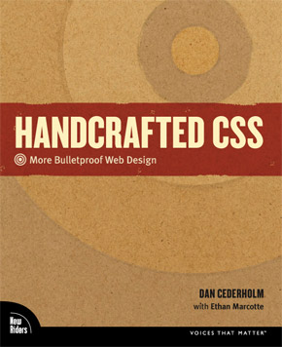
Book
Handcrafted Css by Dan Cederholm and Ethan Marcotte

Slide 13
Useful Tags from Html 5

Slide 14
Unobtrusive Javascript

Slide 15

Book
jQuery in Action by Bear Bibeault and Yehuda Katz

Slide 16
Branch Out with Your Tags

Slide 17

Book
Javascript: The Good Parts by Douglas Crockford

Slide 18
How to Use ySlow

Slide 19

Book
High Performance Web Sites by Steve Souders

Slide 20
Client-Side Templating

Slide 21
IIS SEO Toolkit

Slide 22
Yahoo.com Credited Performance Information
http://developer.yahoo.com/performance/rules.html
Douglas Crockford
Javascript Programming Language (1 of 4)
http://video.yahoo.com/watch/111593/1710507
Advanced Javascript (1 of 3)
http://video.yahoo.com/watch/111585/1027823

